Slide 1
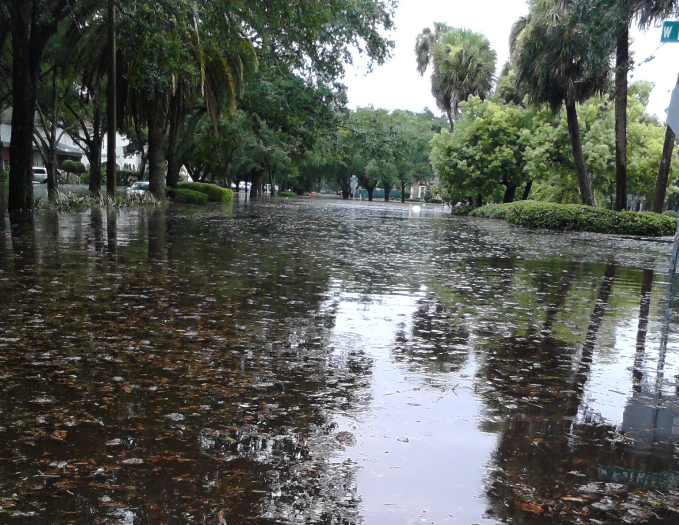
South Howard Flood Relief Project
Capital Improvement Projects
Stormwater Engineering Division
Mobility Department

Slide 2
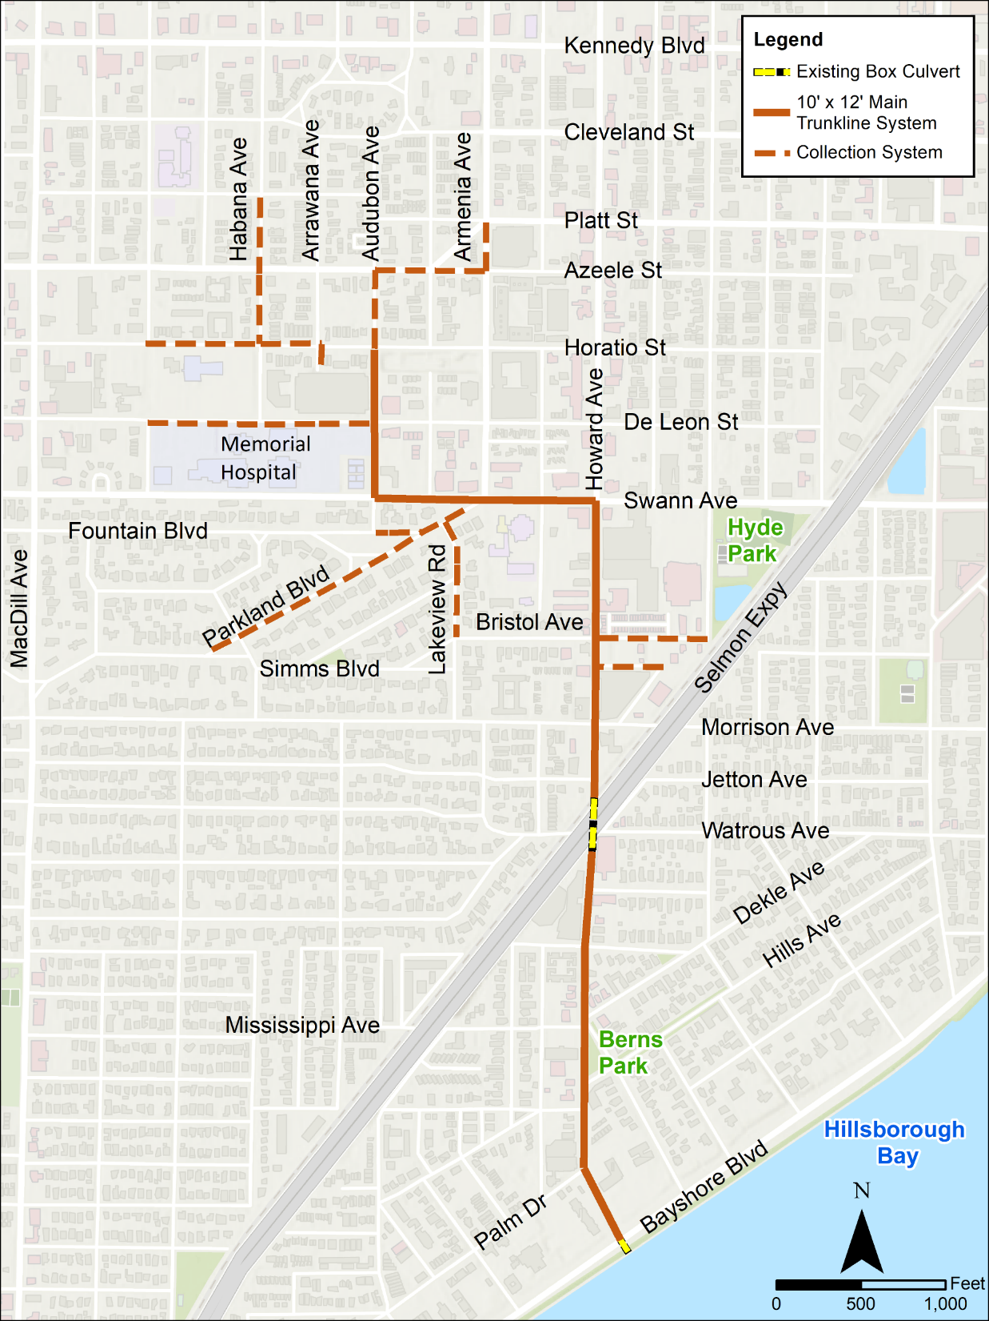
Recommended Route
Notes:
Re-delineation of subbbasins
Redevelop overland flow channels and weirs
Verify pipe connections with as-builts, ERP, field recon
Applied time series data from Cypress/Spanishtown model to new boundary nodes east of AOI

Slide 3
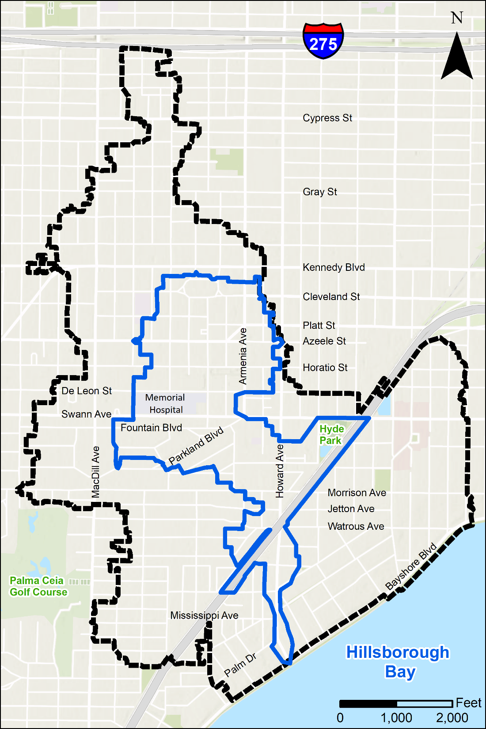
Drainage Area Comparison
Notes:
Re-delineation of subbbasins
Redevelop overland flow channels and weirs
Verify pipe connections with as-builts, ERP, field recon
Applied time series data from Cypress/Spanishtown model to new boundary nodes east of AOI

Slide 4
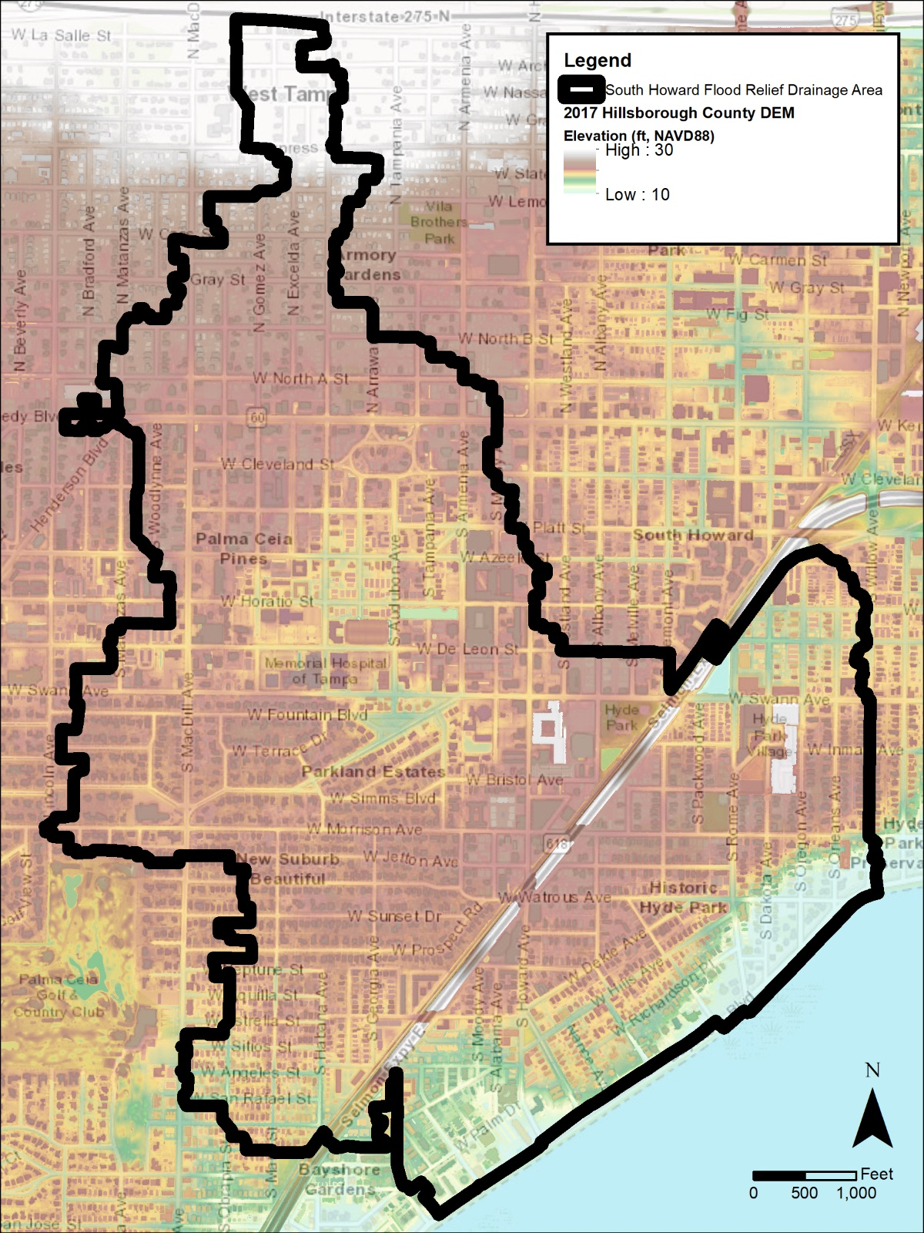
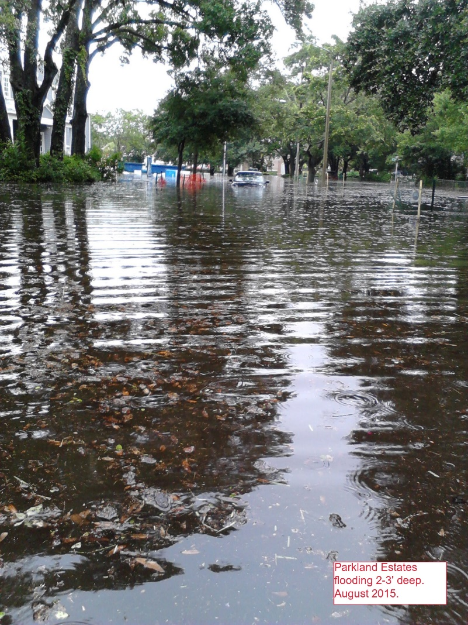
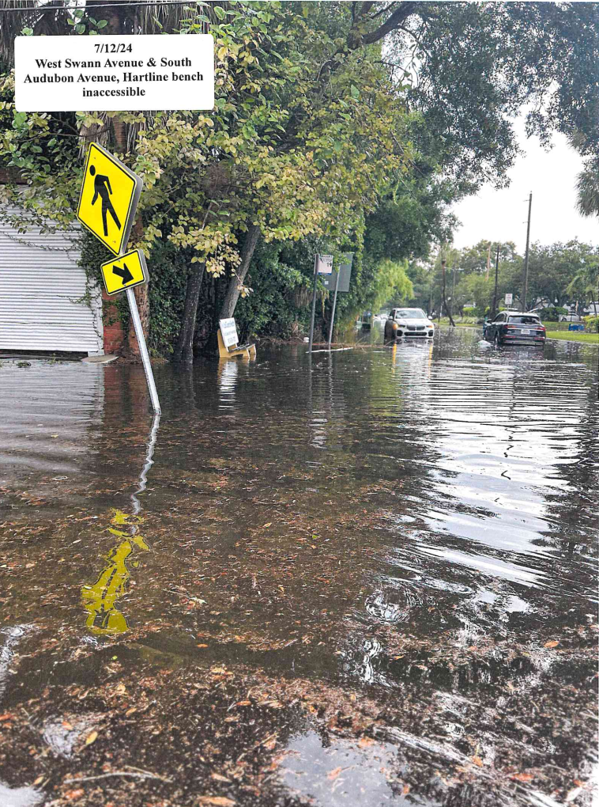
Problem Description
Parkland Estates, August 2015
W Swann Ave at S Audubon Ave, July 2024
Notes:
This presentation will be to introduce the project to members of the community that are not familiar with this project.
Some of this information will be familiar to members that have attended previous meetings.
This is a map of the area that frequently floods in Parkland Estates and Palma Ceia Pines.
The light blue shows the lower elevations in the streets.
This is essentially a low-lying portion of the city that is a bowl collecting rainfall from surrounding area.
Current system that drains this watershed has limited outfall capacity.
A simple definition of a watershed is an area of land that channels rainfall into a body of water downstream. Or a basin which is essentially the same thing. Watershed basin is synomous
We have estimated that structural flooding relieve requires five times more capacity with either a 5’x10’ box culvert or 25-acre pond
For reference, one acre is approximately the size of a football field.

Slide 5
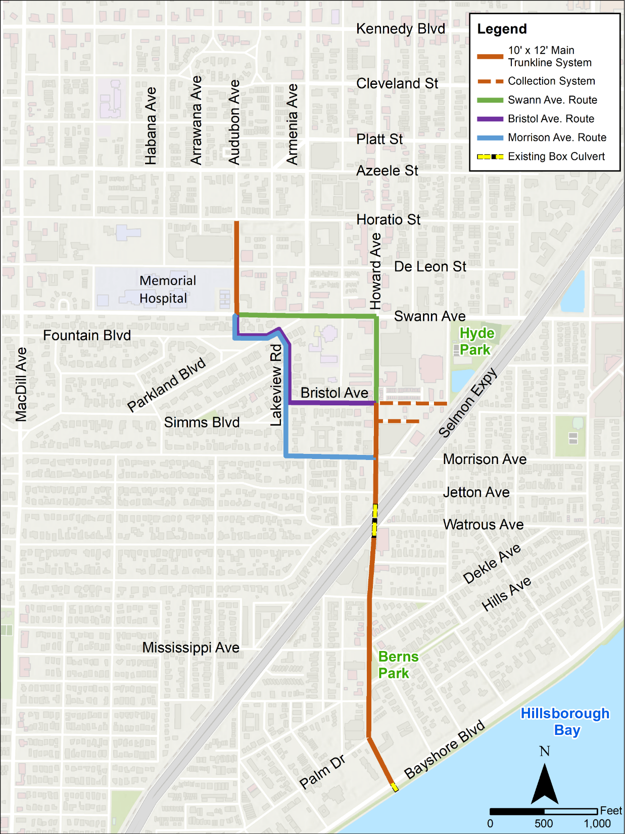
Route Alternatives
Notes:
Re-delineation of subbbasins
Redevelop overland flow channels and weirs
Verify pipe connections with as-builts, ERP, field recon
Applied time series data from Cypress/Spanishtown model to new boundary nodes east of AOI

Slide 6
Recommended Route
Notes:
Re-delineation of subbbasins
Redevelop overland flow channels and weirs
Verify pipe connections with as-builts, ERP, field recon
Applied time series data from Cypress/Spanishtown model to new boundary nodes east of AOI

Slide 7
Reviewed Alternatives
Scenario | Project Alternative | Cost | Route Length (LF) | Hydraulic Efficiency | Temporary Impacts to Adjacent Property | Constructability | CSX Crossing | ROW/Easements Needed
1 | Morrison
2 | Bristol
3 | Swann
4 | Georgia to Mississippi
5 | Morrison to Rome
6 | CSX 1
7 | CSX 2
8 | CSX 3
Notes:
*Ability to meet flood reduction goal is dependent on what capacity pipes can be installed under Selmon and CSX via microtunnel
**Estimated cost reflects new outfall needed to make project hydraulically effective

Slide 8
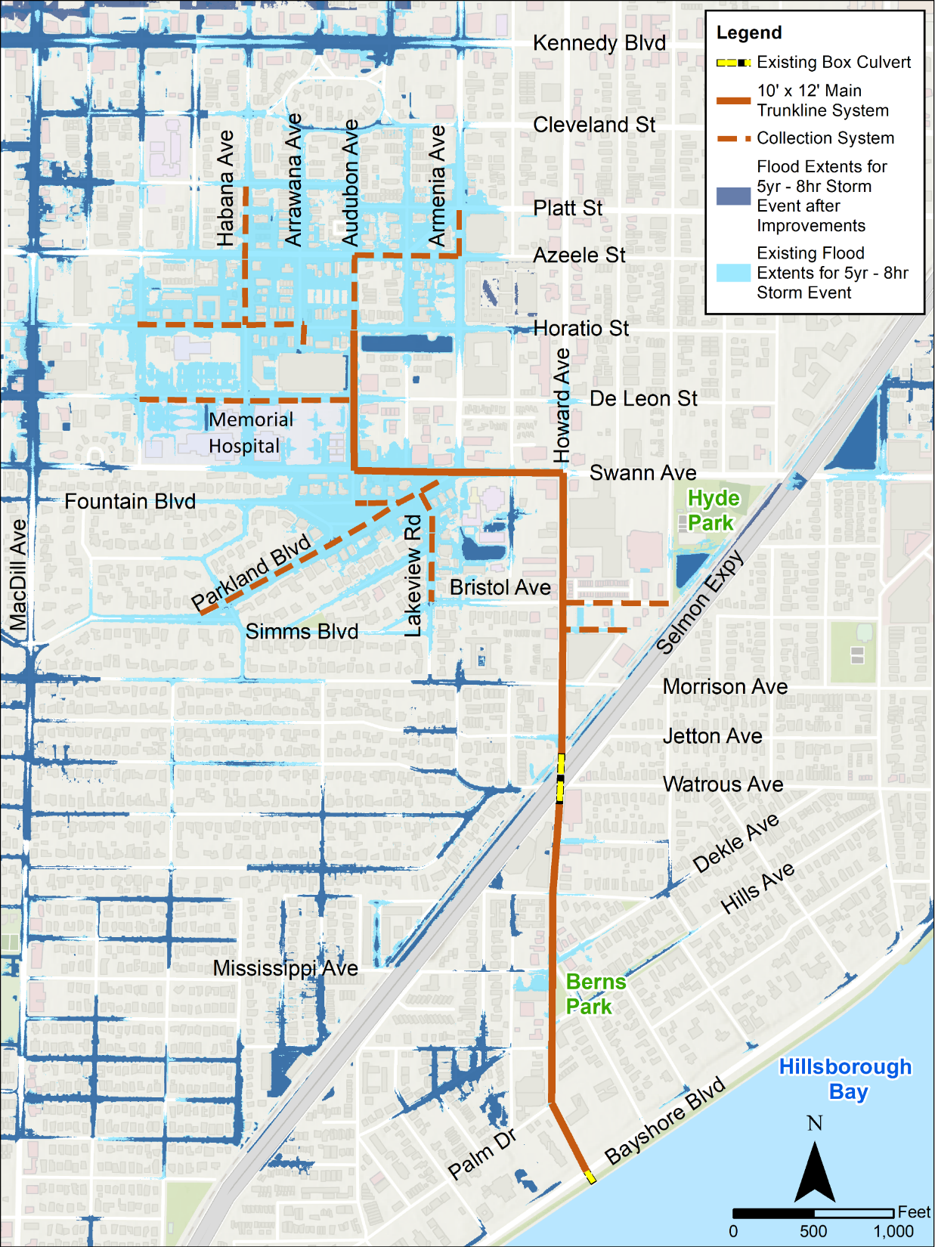
Flood Reduction Benefits
Notes:
Re-delineation of subbbasins
Redevelop overland flow channels and weirs
Verify pipe connections with as-builts, ERP, field recon
Applied time series data from Cypress/Spanishtown model to new boundary nodes east of AOI

Slide 9
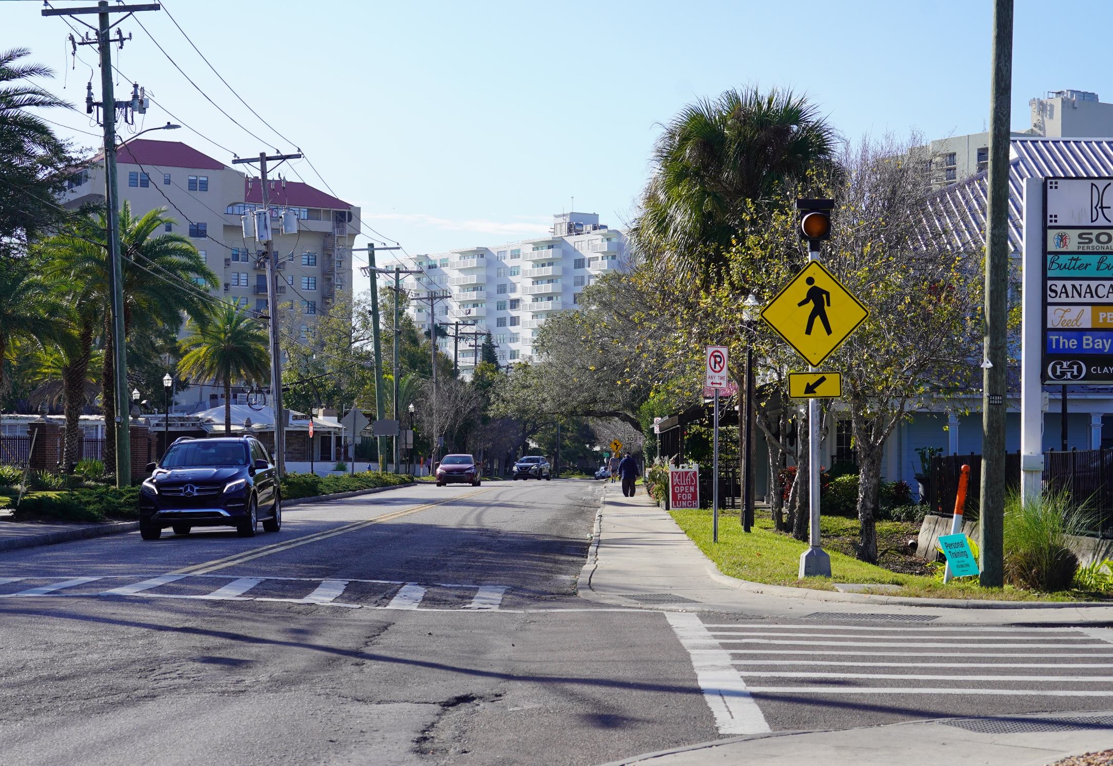
Benefits Beyond Flood Relief
Establish stormwater spine for future flood relief projects
Improve roadways in and near project area
New, upgraded utilities
Improve water quality discharges to the Bay
All new streetscape on South Howard
9

Slide 10
Existing Corridor Character
S. Howard Ave.
S. Howard Ave.

Slide 11
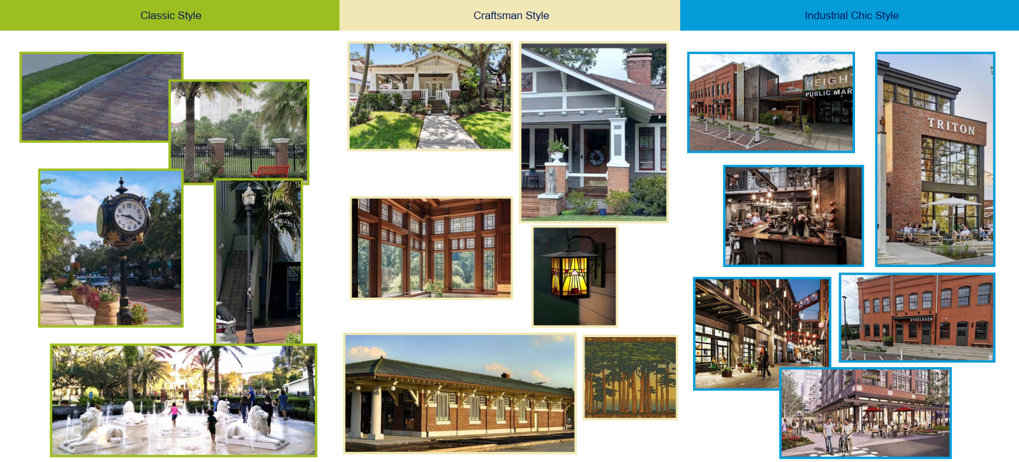
Potential Design Theme Inspirations
11

Slide 12
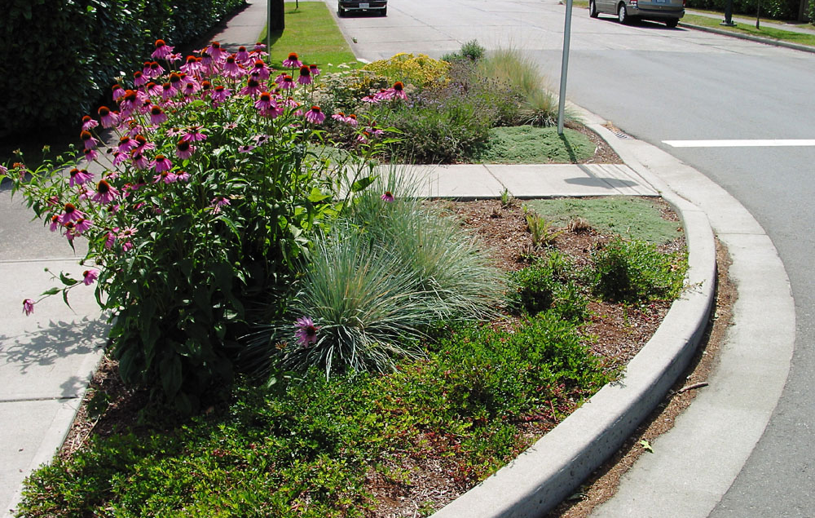
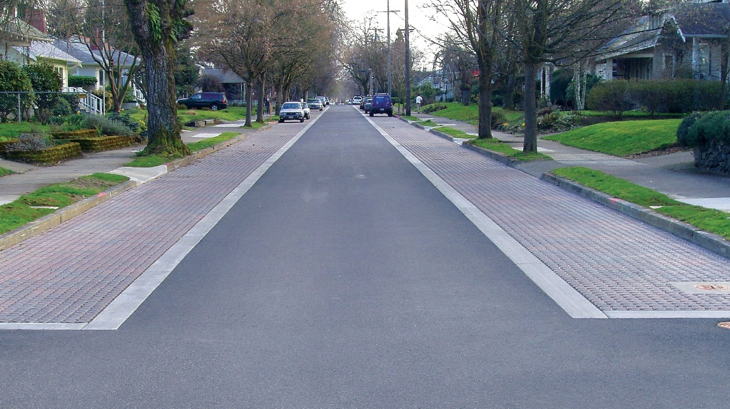
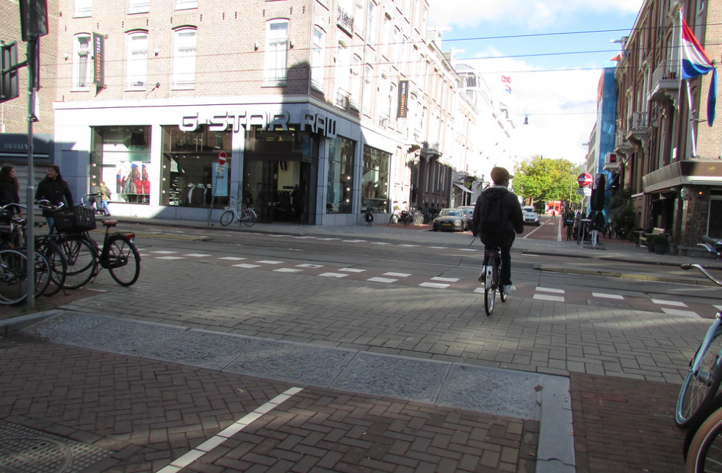
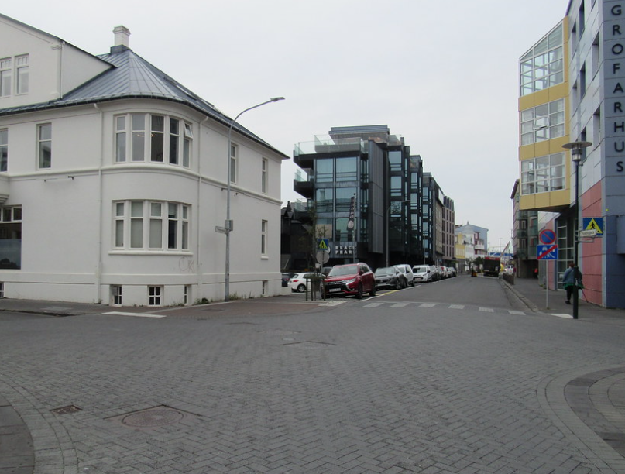
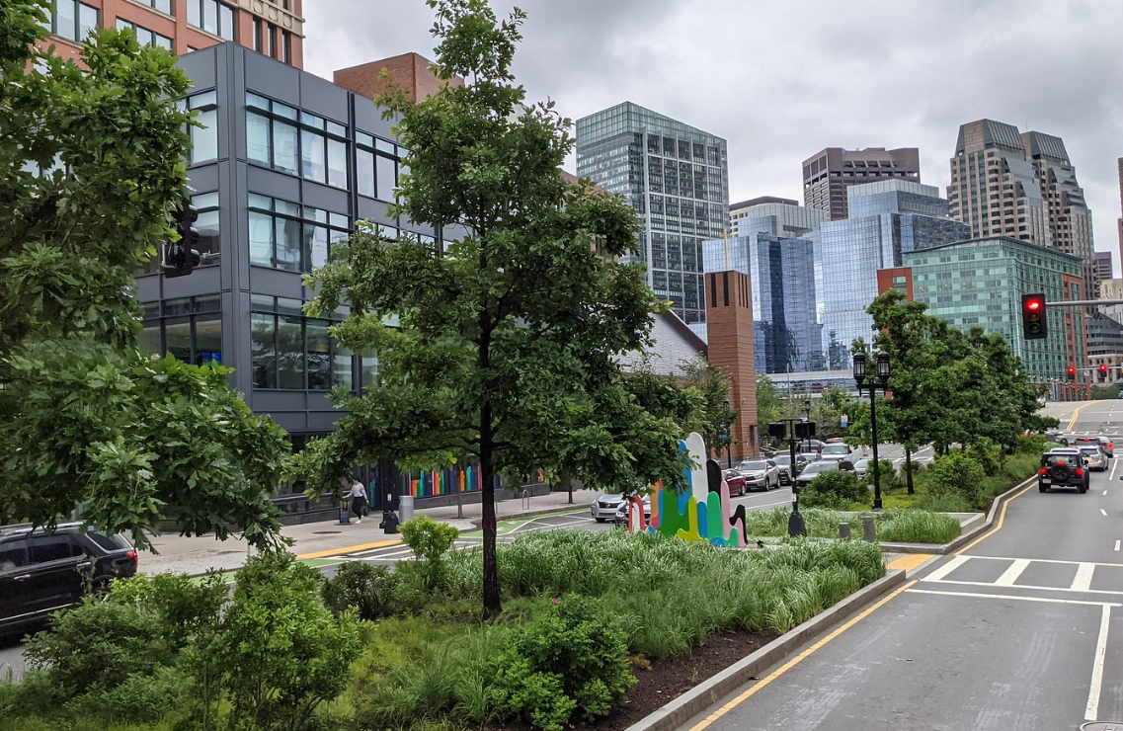
Potential Design Features
Raised Sidewalk Crossing
Landscaped Curb Extension
Pervious Parking
Raised Sidewalk Crossing
Brick Street
Landscaped Median

Slide 13
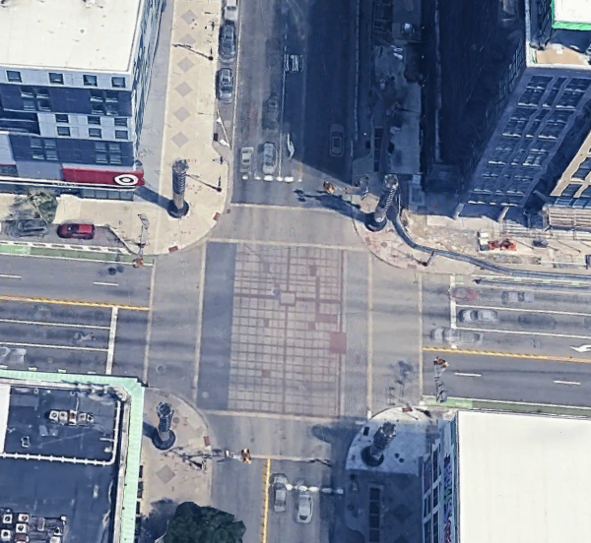
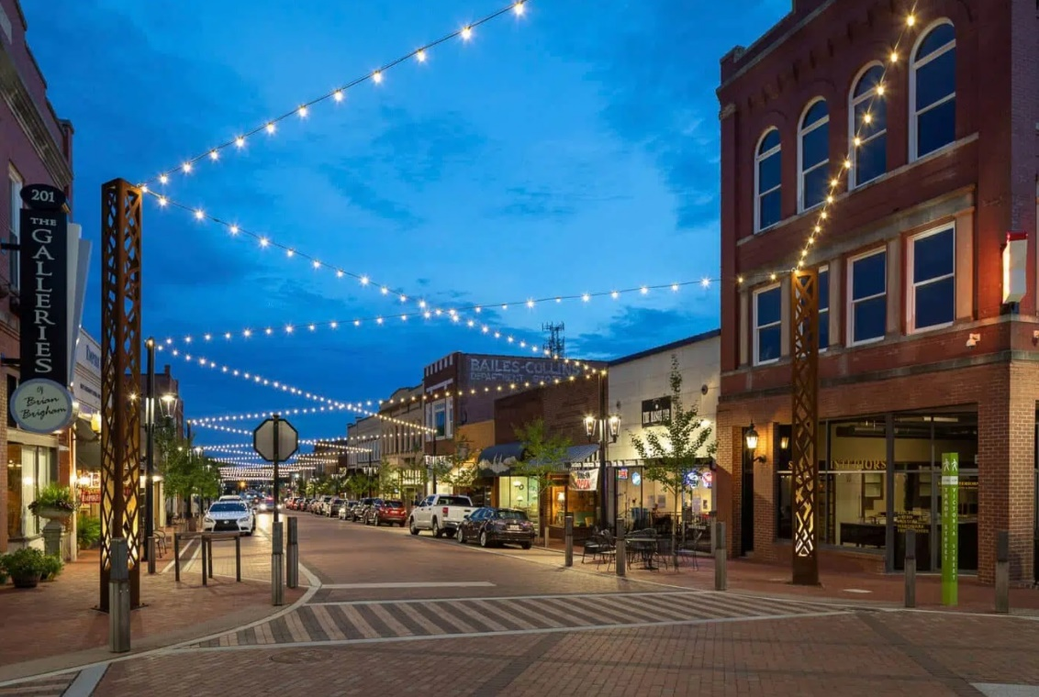
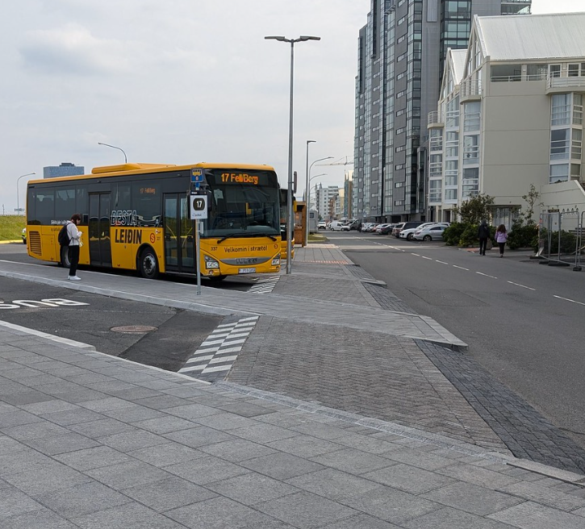
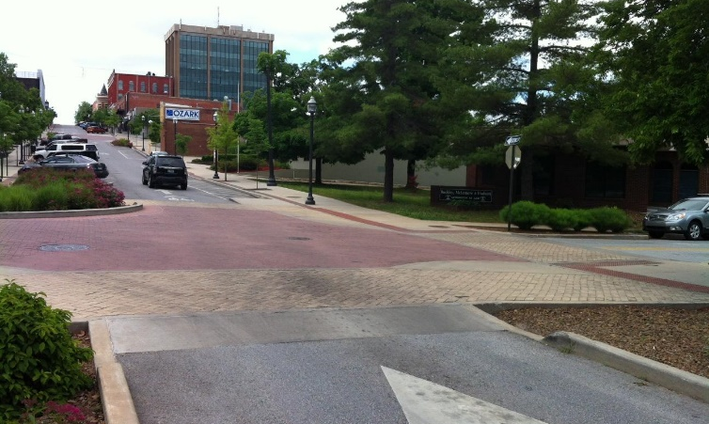
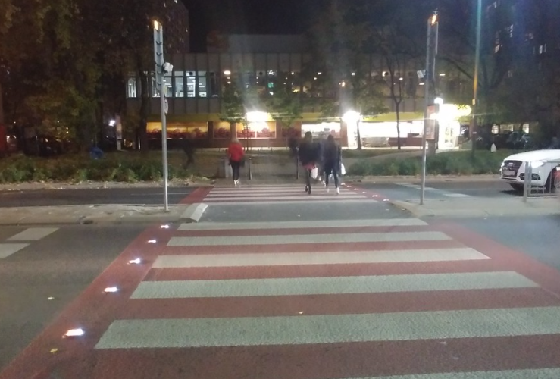
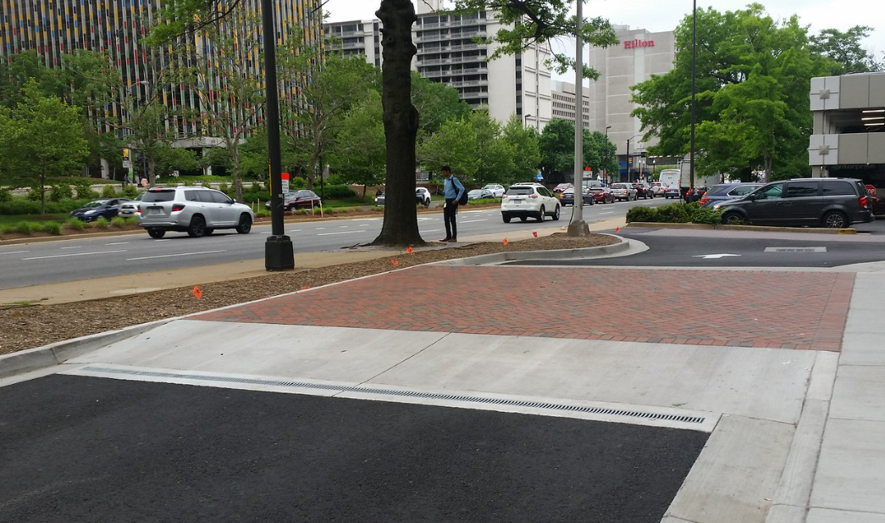
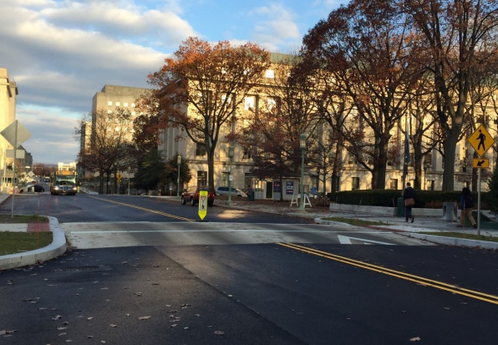
Potential Design Features
Decorative intersection
String Lights
Raised Sidewalk Crossing
Raised Intersection
Lighted crosswalk
Raised Crosswalk
Raised Crosswalk

Slide 14
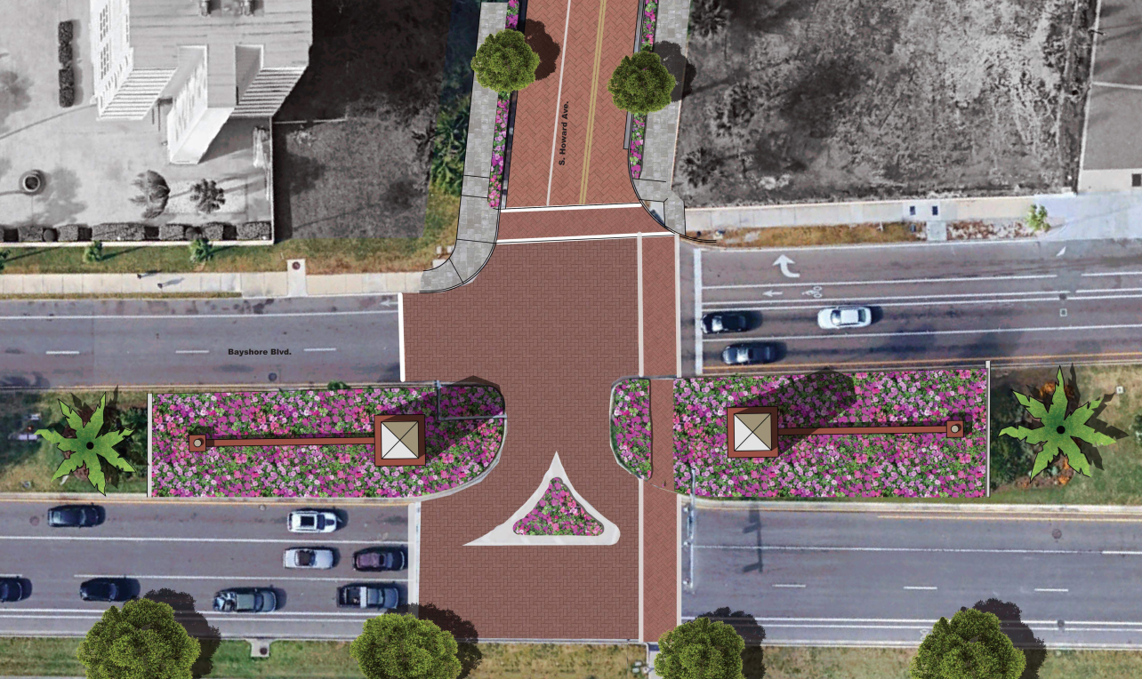
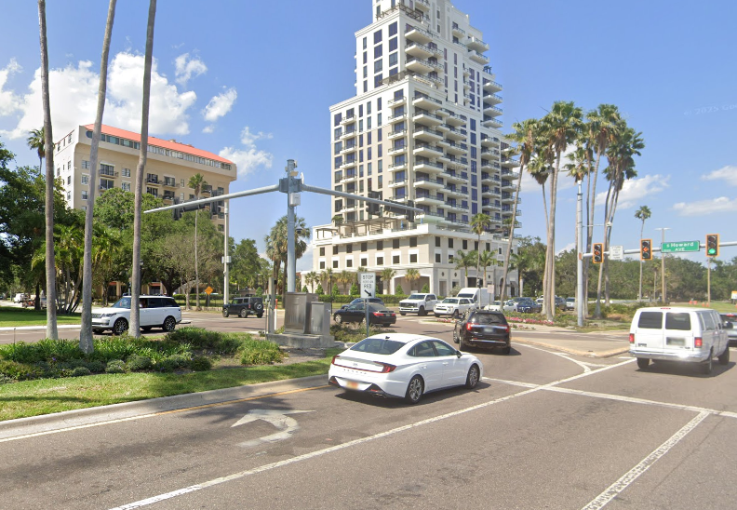
Potential Bayshore Gateway
Enhanced landscaping opportunity
Decorative intersection treatment
Potential monument structures
Raised crossings
S. Howard Ave.
Bayshore Blvd.

Slide 15
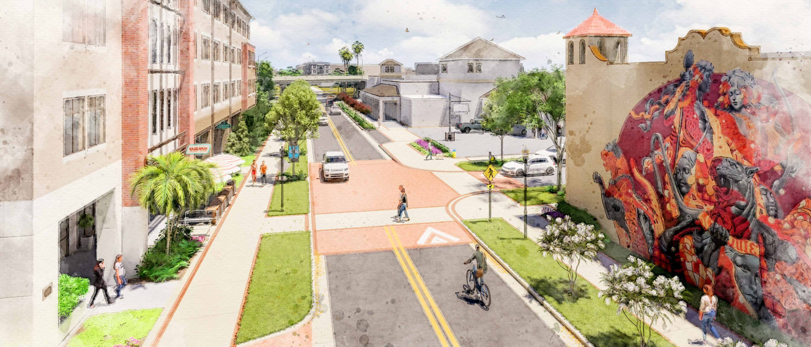
Concept Design at Marjory Ave.

Slide 16
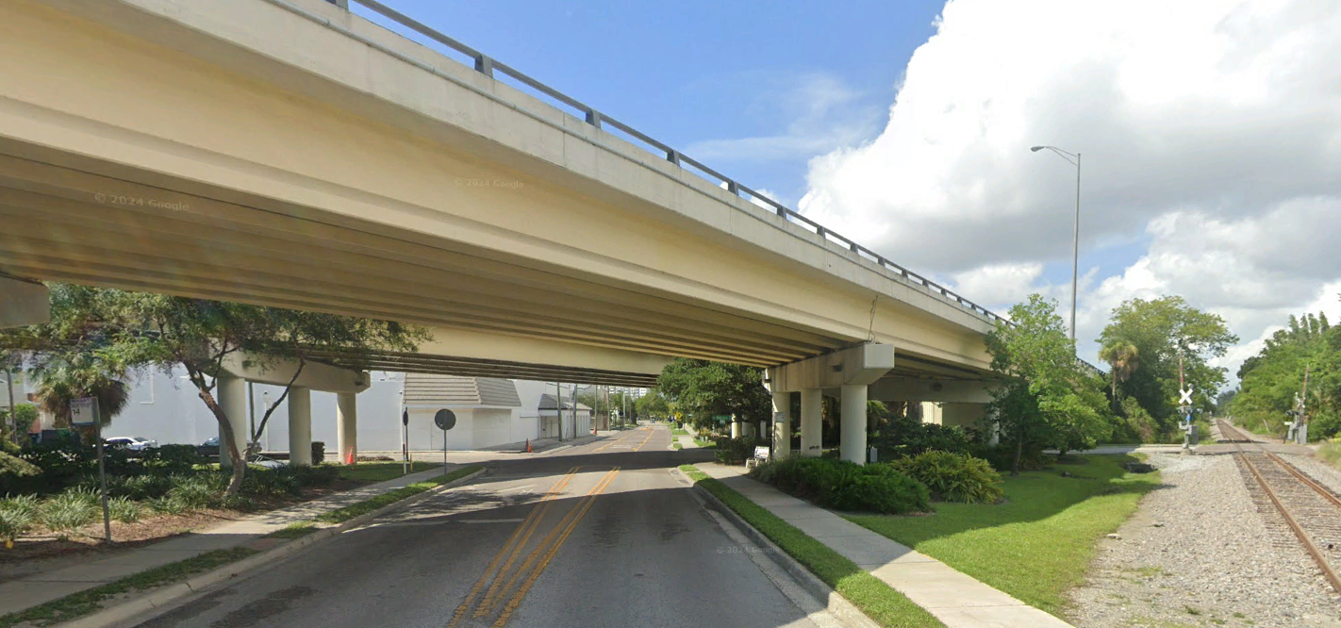
Selmon Expressway Overpass
16

Slide 17
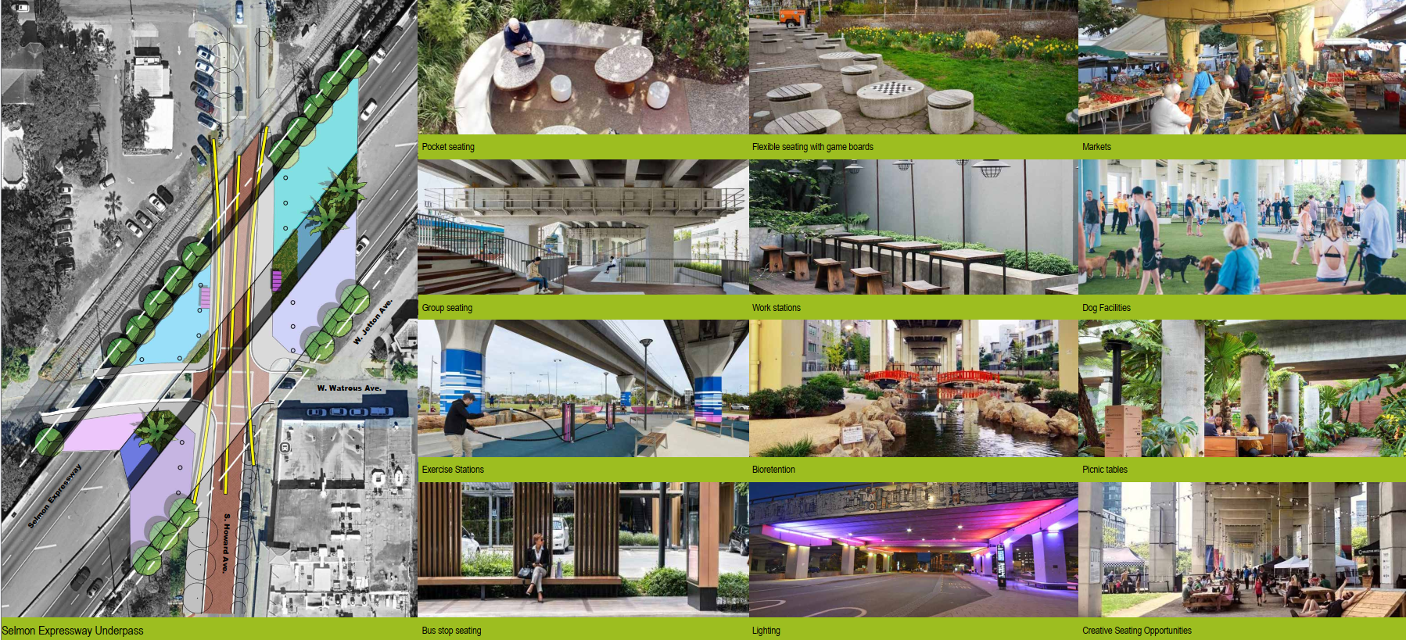
Potential Selmon Expressway Gateway
17

Slide 18
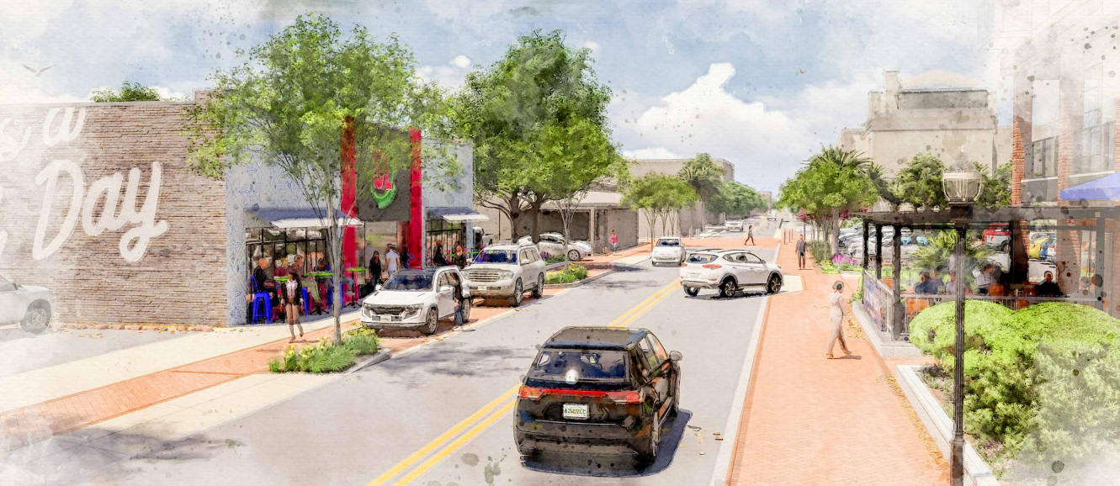
Concept Design north of Morrison Ave.

Slide 19
Schedule
Preliminary Schedule:
Modeling & Final Route: Dec. 2024 to May 2025
Preliminary Design Report: Late Summer 2025
Design Phase: May 2025 to Spring 2026
Early Works Construction: Begin Early Fall 2025
Major Construction: Spring 2026 to Summer 2029
Next Public Meeting: Fall 2025
19

